Slide 1
Health Data and Information Integration

Slide 2
HITECH Act
HITECH Act = Health Information Technology for Economic and Clinical Health Act (2/17/2009)
Privacy Stuff
Incentives for the “Meaningful Use” of certified EHR technology
  Must begin use prior to 2014
  No incentive payments after 2016

Slide 3
HITECH Act
“MU” in First Year (2013 or 2014) = $15,000
“MU” in First Year (2011 or 2012) = $18,000
“MU” in Second Year = $12,000
Third Year = $8,000
Fourth Year = $4,000
Fifth Year = $2,000
Increase in payments for use in a Health Professional Shortage Area
“Meaningful Use” =
  Certified EHR Technology, including ePrescribing
  Information Exchange – connected in a manner that allows for the electronic exchange of HI, including care coordiation
  Reporting on Measures using EHR
    Clinical Quality Measures

Slide 4
Public Health Information Systems
Weissman Article – “Advancing Health Care Equity Through Improved Data Collection” – NEJM (2011)
Collecting Data – Community Health Assessments
  Identify health issues in a community and develop programs to combat these health issues – what could be simpler?
Challenges – Diverse Data Collection (different types of data), Diverse collection sites/repositories, race/ethnic group info, geocoding w/surnames
Right data to the right people at the right time

Slide 5
Geographic Information Systems
GIS incorporates:
  Incorporation of data
  Storage of data
  Retrieval of data with a spatial or geographic component
  Analysis and display of data on maps
Useful input/data
  Should include race/ethnicity, address, zip codes…what else?
Limitations include
  Limited availability of data
  Inconsistent data quality
  Lack of a trained workforce
  Costs

Slide 6
Using HIS for PH Administration
HIS need to make optimal use of the mounting supply of health-related data
Inform managerial decision making and improve operations
HIS supports a wide variety of PH system objectives
HIS Architectures – pgs. 273-282
Integration
Data Information Knowledge Wisdom

Slide 7
Public Health Surveillance
Surveillance systems monitor infections and chronic conditions, injury and disability, occupational health and safety, environmental exposures, maternal and child health, health awareness and behavior, and the use of healthcare services.
Can act as a “trigger” to potential PH problems
Sentinel surveillance = refers to convenience sampling of data that are designed to characterize the magnitude of a PH problem in a larger population.
Sentinel health event – refers to a disease or condition for which the occurrence of even a single case warns that improvements in preventative measures are warranted
  Single case of polio or a maternal death

Slide 8
Public Health Surveillance
Syndromic Surveillance – designed to track early outbreak detection, which can create the opportunity for rapid intervention to interrupt infectious disease transmission and prevent morbidity and mortality.
  Tracks increased illness frequency within a population rather than specific clinical diagnoses
Idea that certain signs and symptoms will manifest and cluster if a particular PH issue is present
Preparation, data gathering, reporting = action

Slide 9
HIS in Michigan
Michigan Health Information Network (MiHIN)
Regional computer systems/data aggregators
Goal is to allow for better communication between different parts of the healthcare system
  Payors, Providers, Public Health?

Slide 10
Telemedicine/eHealth/mHealth
Telemedicine (WHO): The delivery of health care services, where distance is a critical factor, by all health care professionals using information and communication technologies for the exchange of valid information for diagnosis, treatment and prevention of disease and injuries, research and evaluation, and for the continuing education of health care providers, all in the interests of advancing the health of individuals and their communities.
eHealth (WHO): E-health is the transfer of health resources and health care by electronic means. It encompasses three main areas:
  The delivery of health information, for health professionals and health consumers, through the Internet and telecommunications.
  Using the power of IT and e-commerce to improve public health services, e.g. through the education and training of health workers.
  The use of e-commerce and e-business practices in health systems management.
mHealth (Gulick): The use of smartphones and cellular phone technology to deliver health care services where distance is a critical factor.

Slide 11
History of Telehealth & Telemedicine
Drums, horns, beacon fires…
Late 1800’s/early 1900’s – telephone is adopted
  Infrastructure required
1924: Radio Doctor
1950: Transmission of radiologic images by telephone (24 miles)
1959: 2-way interactive television at University of Nebraska (neurological examinations)

Slide 12
History of Telehealth & Telemedicine
1963: Massachusetts General Hospital and nurse station at Boston’s Logan Airport
1967: Miami School of Medicine and City of Miami Fire Dept. EKG rhythms from ambulances to the hospital
1980’s: Public-sponsored programs

Slide 13
History of Telehealth & Telemedicine
1980’s: High transmission costs (of data) serve as the primary obstacle to Telemedicine programs
1990’s: The Internet (commercial adoption) [eHealth]
Present:
  University of New Mexico Center for Telehealth and Cybermedicine Research
  http://hsc.unm.edu/som/telehealth/

Slide 14
The Need
Significant increase in the U.S. population—estimated growth of 20 percent
(to 363 million) between 2008-2030
Shortage of healthcare professionals being educated, trained and licensed
Increasing incidence of chronic diseases around the world, including
diabetes, congestive heart failure and obstructive pulmonary disease
Need for efficient care of the elderly, home-bound, and physically
challenged patients
Lack of specialists and health facilities in rural areas
Adverse events, injuries and illness at hospitals and physician’s offices
Need to improve community and population health
U.S. Dept of Commerce Report - 2009

Slide 15
Telemedicine Market
U.S. Market worth $600 Million in 2007 (expected to grow at compounded rate of 56% over 5 years).
Global telehealth market set to exceed $1 Billion by 2016.
Global telehealth market to hit $6.28 Billion by 2020.
Innovation likely to be driven by small companies.

Slide 16
Teleradiology & Telepathology
Ideally suited for Telemedicine adoption
Resolution of monitors/pictures crucial
Reimbursement (Medicare)
NightHawks – radiology services from India

Slide 17
Types of Programs
Face-to-face: Video consultations
  Shortage of specialists
Data transmission (Live and Store and Forward)
  Teleradiology/teledermatology
  ECG information
  Weight, heart sounds, blood pressure
Collaboration
  Research
Education
  Internet
  Teleconferencing

Slide 18
Assessing Telemedicine Programs
Institute of Medicine Report
Quality
Accessibility
Cost
Acceptability (Patient and Provider)

Slide 19
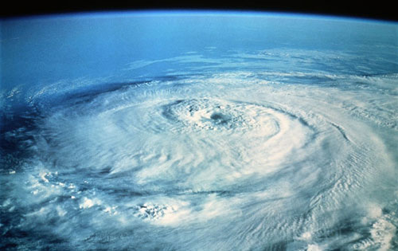
eHealth
Adoption of EMR/EHRs (HITECH Act)
Computer-savvy doctors and patients
“Perfect Storm” for Internet-based practice of medicine
Cyberdocs – one of the earliest commercial applications of telemedicine (late 1990’s, early 2000)
Legal issues

Slide 20
mHealth
Simple – PillScheduler
Advanced – Cardiology (EKGs)
Rehabilitation/Post-Op Monitoring

Slide 21
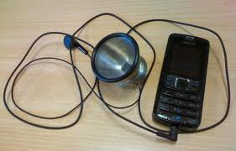
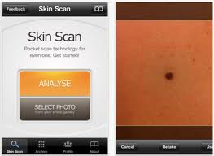
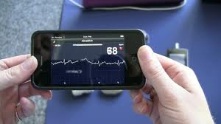
mHealth
Cardiology
Dermatology

